Slide 1
BAUHAUS HUNGARY Webshop campaign 2022

Slide 2
STRATEGY

Slide 3
STRATEGY
Task
To promote the communication of the Bauhaus online shop while building the brand further.

Slide 4
STRATEGY
Proposed message
Thanks to our online shop, the professional solutions of Bauhaus are now available throughout the country, allowing customers full access to a wide range of home improvement products wherever they are.
If it has to be good.

Slide 5
CREATIVE CONCEPT

Slide 6
You can enter Bauhaus from anywhere.

Slide 7
Insight
Even the nearest Bauhaus store is a long drive from me. If only there was some way to bring the store closer to me…

Slide 8
Concept
Wherever there’s a need, there’s a Bauhaus.
Whether it’s your living room or your kitchen, you can enter the world of Bauhaus from anywhere (as long as you’ve got an internet connection). Our online webshop brings you the best of the Bauhaus stores right into your home – quite literally. Because if it has to be good, you need Bauhaus.

Slide 9
The Role of Bauhaus and its Online Shop
Just because there’s no Bauhaus store near you, you don't have to give up on our expertise, quality, and choice selection of products, as all of this is available to you on our web shop.

Slide 10
TVC – Original edition, 20 sec

Slide 11
TVC
In both commercials, we see just the moment when a problem arises. Our heroes notice that the tiles were placed on the kitchen wall incorrectly or that the living room door needs replacing.
No problem, as they salvage the situation on the spot: our heroes enter a Bauhaus store right from their home! After all, you can enter the Bauhaus webshop anywhere, anytime if you need expert help and a huge selection of products.
The structure of the films is the same: it starts with a need; the protagonist enters the store; then finds a solution.

Slide 12
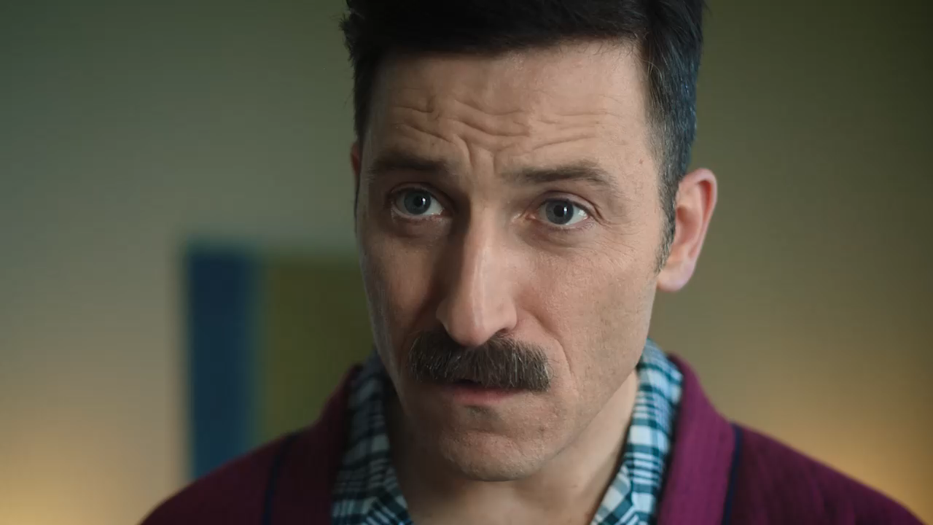
TVC 1
Voice over:
You can enter Bauhaus from anywhere.
Bauhaus – If it has to be good.

Slide 13
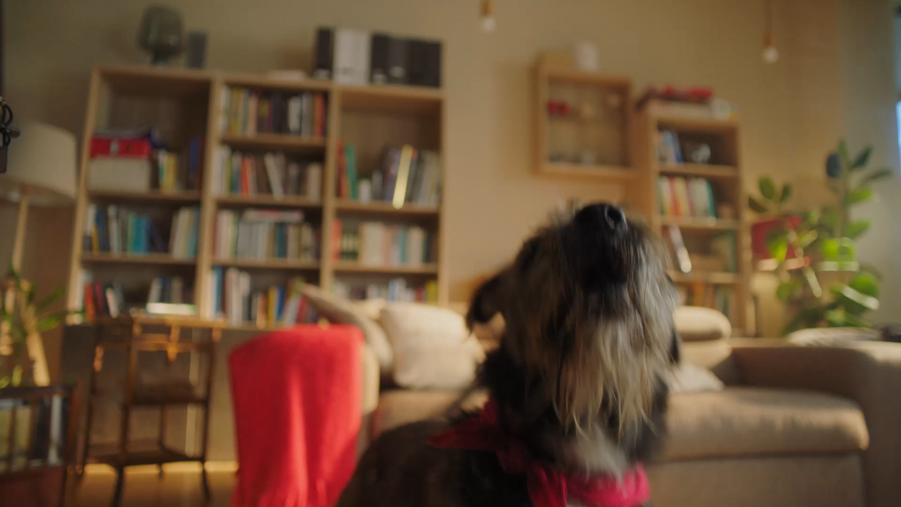
TVC 2
Voice over:
You can enter Bauhaus from anywhere.
Bauhaus – If it has to be good.

Slide 14
TVC – 15th birthday edition, 25 sec

Slide 15
TVC
The structure of these commercials is the same as those of the 20 sec films: it starts with a need; the protagonist enters the store; then finds a solution. The only difference is the added 5 second tag, dedicated to the 15 wonderful years Bauhaus has been on the Hungarian market.

Slide 16
TVC 1
Voice over:
You can enter Bauhaus from anywhere.
Bauhaus – If it has to be good.
Bauhaus – 15 years in Hungary. Thank you for your trust!

Slide 17
TVC 2
Voice over:
You can enter Bauhaus from anywhere.
Bauhaus – If it has to be good.
Bauhaus – 15 years in Hungary. Thank you for your trust!

Slide 18
BANNERS

Slide 19
STATIC BANNERS
We use the same imagery and messaging on the banners as in the TVC.

Slide 20

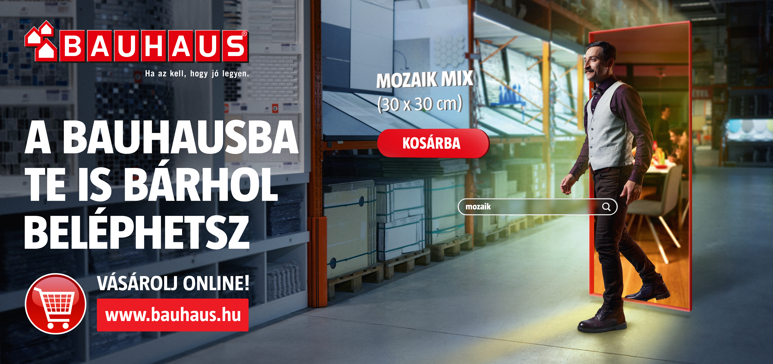
STATIC BANNERS 1
You can enter Bauhaus from anywhere.
Shop online! www.bauhaus.hu
Bauhaus – If it has to be good.

Slide 21
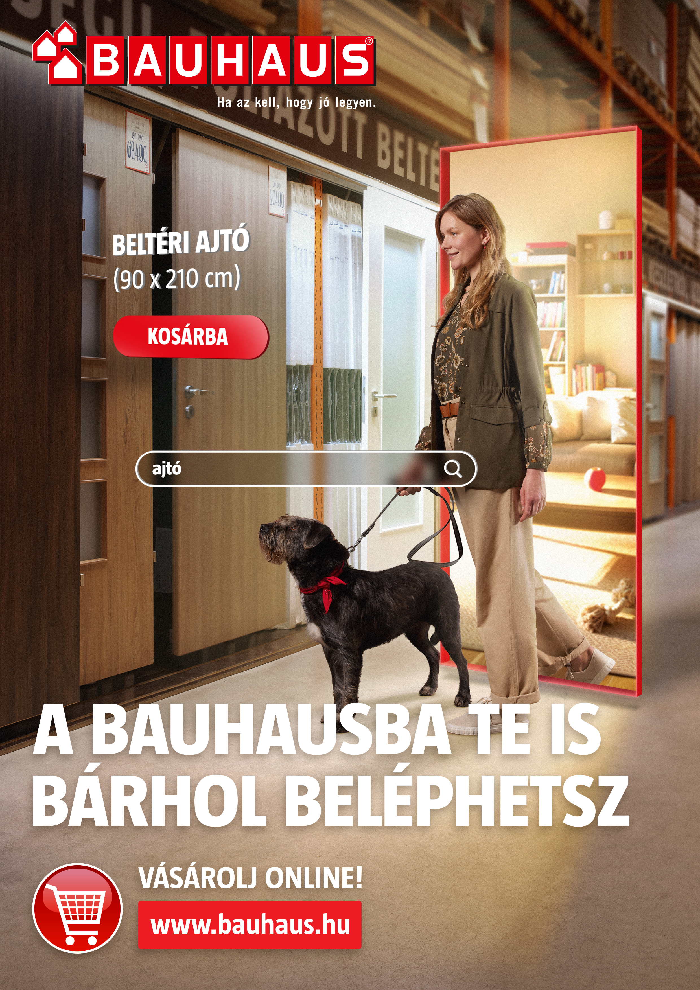

STATIC BANNERS 2
You can enter Bauhaus from anywhere.
Shop online! www.bauhaus.hu
Bauhaus – If it has to be good.

Slide 22
ANIMATED BANNERS FOR OUR CATALOGUE (5 sec)
We use the same messaging on the banners and scenes from the TVC in animation.

Slide 23
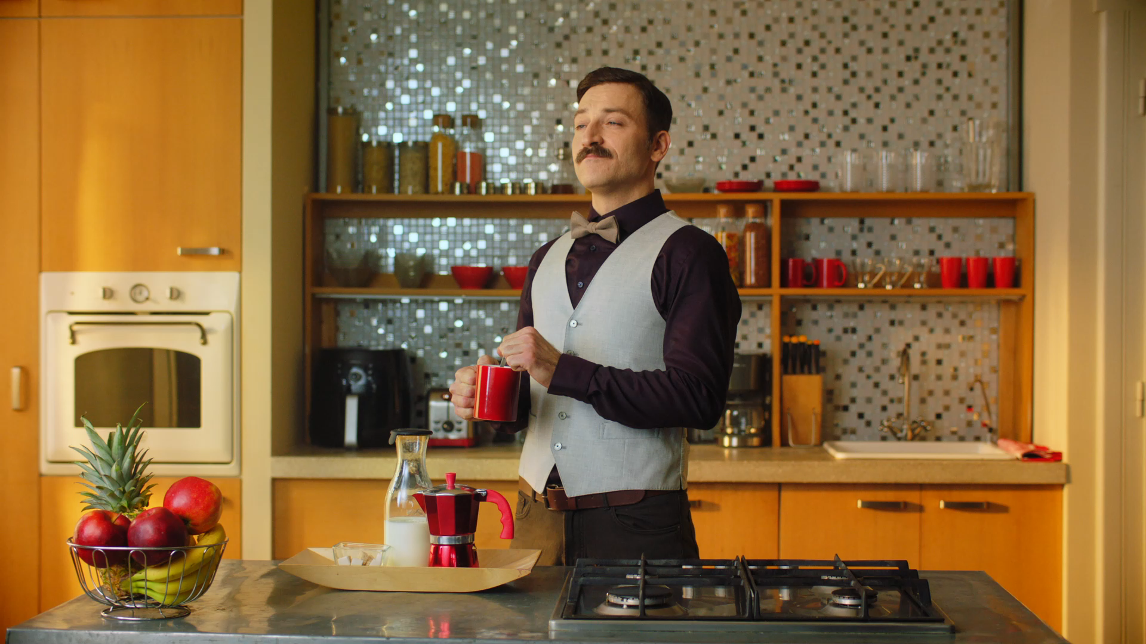
ANIMATED BANNERS 1

Slide 24
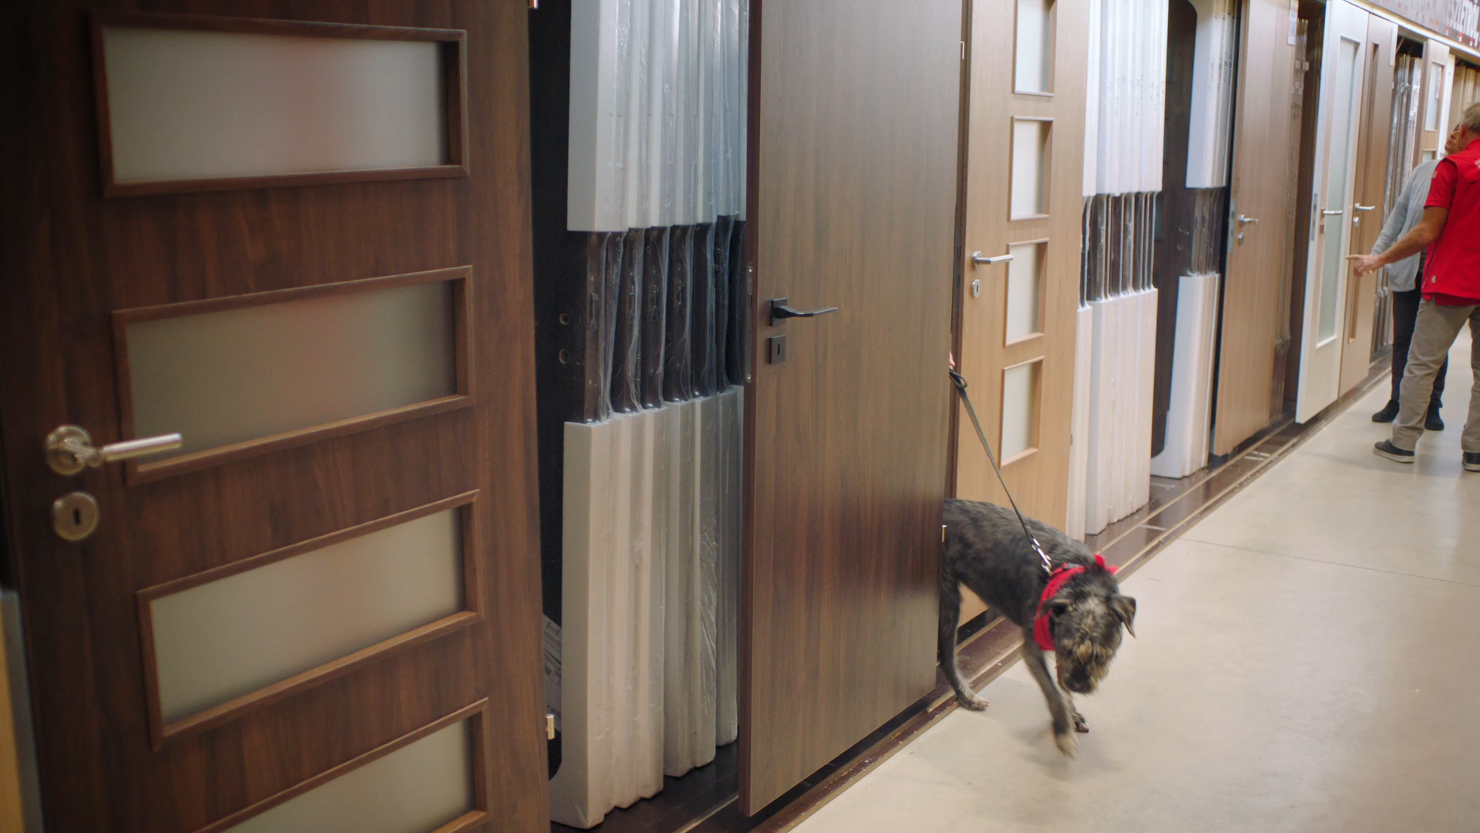
ANIMATED BANNERS 2

